Slide 1
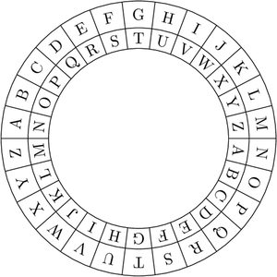
STMIK
Balikpapan
TUGAS 01
M.K. KRIPTOGRAFI
Judul :
Algoritma
Enkripsi
ROT13
Oleh :
Rizqi Nur Assyaufi / 15.01.157
20170925
…/Presentation_ROT13_MK_Kriptografi_RizqiNurAssyaufi_1501157.odp
01/13

Slide 2

…/Presentation_ROT13_MK_Kriptografi_RizqiNurAssyaufi_1501157.odp
02/13

Slide 3
Topik Bahasan :
Bahasa pemrograman apa yang digunakan ?
Algoritma program ?
Method / Function apa yang digunakan ?
Let’s Ngoding !
Let’s GUI (Graphic User Interface) !
…/Presentation_ROT13_MK_Kriptografi_RizqiNurAssyaufi_1501157.odp
03/13

Slide 4

Bahasa Pemrograman :
Kenapa JavaScript ?
include in Modern Browser
no need to install
has many Standard built-in object
integrated with HTML5 & CSS3
…/Presentation_ROT13_MK_Kriptografi_RizqiNurAssyaufi_1501157.odp
04/13

Slide 5
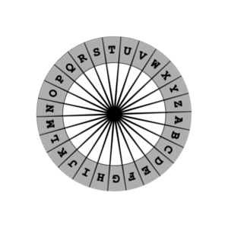
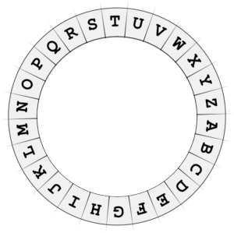
Algoritma Caesar ROT13 :
…/Presentation_ROT13_MK_Kriptografi_RizqiNurAssyaufi_1501157.odp
05/13

Slide 6
Algoritma Program :
index = 0
move > panjang input
CONDITION 1
x >= A && x <= M
START
INPUT
PROCESS
for()
kata /
kalimat
O
O
x
x
CONDITION 2
x >= N && x <= Z
O
x
else
CONDITION 3
save VALUE to
variabel[]
O
variabel[]
+13
-13
x
END
OUTPUT
…/Presentation_ROT13_MK_Kriptografi_RizqiNurAssyaufi_1501157.odp
06/13

Slide 7
Let’s
Ngoding,
Bro!
…/Presentation_ROT13_MK_Kriptografi_RizqiNurAssyaufi_1501157.odp
07/13

Slide 8
Method / Function built-in JavaScript :
string.charCodeAt()
The charCodeAt() method returns an integer between 0 and 65535 representing the UTF-16 code unit at the given index.
String.fromCharCode()
The static String.fromCharCode() method returns a string created by using the specified sequence of Unicode values.
…/Presentation_ROT13_MK_Kriptografi_RizqiNurAssyaufi_1501157.odp
08/13

Slide 9
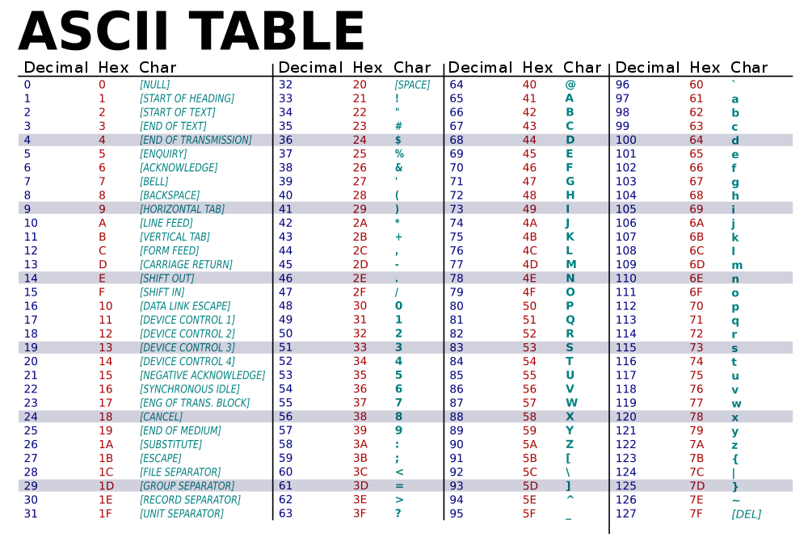
…/Presentation_ROT13_MK_Kriptografi_RizqiNurAssyaufi_1501157.odp
09/13

Slide 10
Let’s
GUI,
Bro!
…/Presentation_ROT13_MK_Kriptografi_RizqiNurAssyaufi_1501157.odp
10/13

Slide 11
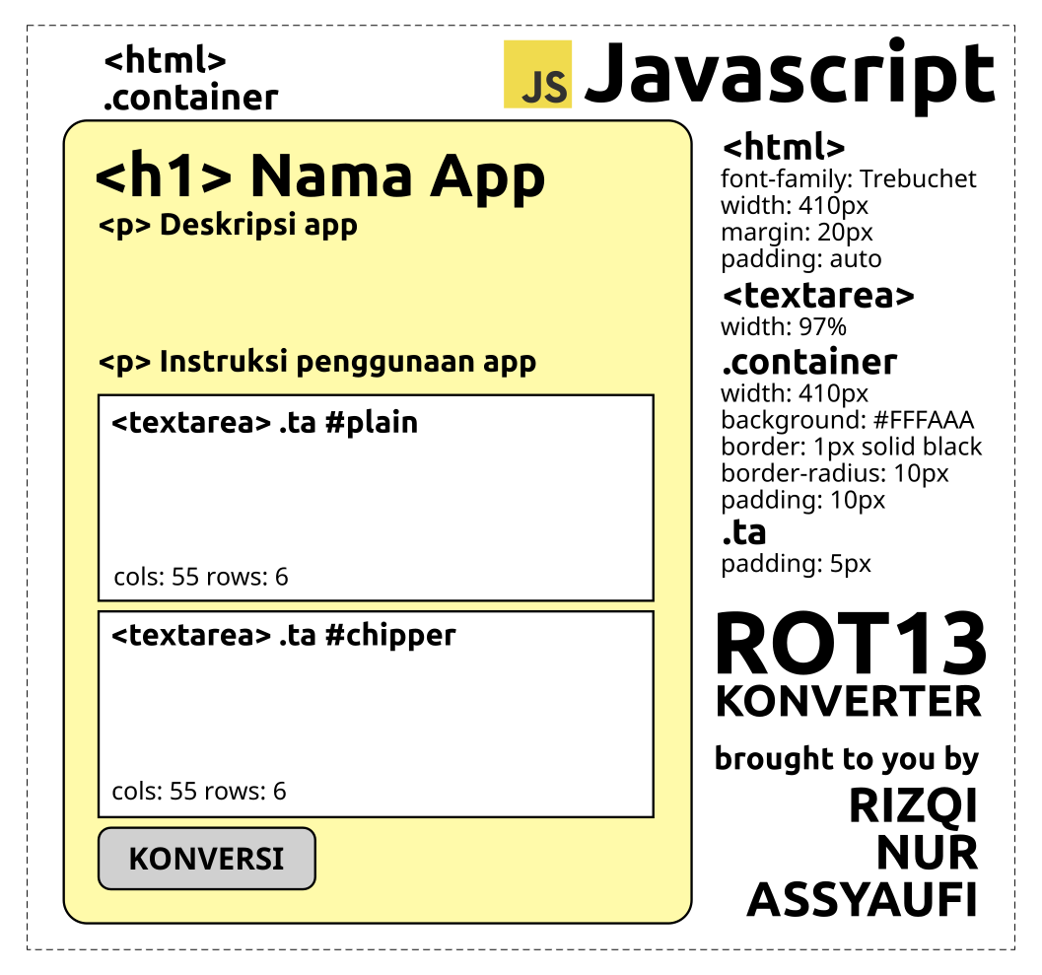
Mockup User Interface Design :
…/Presentation_ROT13_MK_Kriptografi_RizqiNurAssyaufi_1501157.odp
11/13

Slide 12

…/Presentation_ROT13_MK_Kriptografi_RizqiNurAssyaufi_1501157.odp
12/13

Slide 13

Terima Kasih
…/Presentation_ROT13_MK_Kriptografi_RizqiNurAssyaufi_1501157.odp
13/13

